Slide 1

ALZHEIMER’S PREDICTION OPTIMIZATION USING HPC
SUBMITTED BY:
S R KOUSALYA – 22BCE5225 HARINI L – 22BCE5233
YOGESHWARAN A – 22BCE5213

Slide 2
PROBLEM STATEMENT:
Alzheimer’s disease is difficult to detect early due to subtle brain changes and complex neuroimaging data. Traditional ML methods struggle with computational efficiency, accuracy, and scalability on large MRI datasets. These models require long training times and manual hyperparameter tuning, limiting real-time application. Rising volumes of medical imaging demand faster, more automated, and more accurate prediction systems. There is a need for a high-performance solution that enables scalable, real-time classification of Alzheimer's stages.

Slide 3
OBJECTIVES:
Develop a deep learning framework for early and accurate Alzheimer’s disease classification using MRI scans.
Leverage High-Performance Computing (HPC) to improve training speed and model scalability.
Implement parallel processing and distributed training using MPI to handle large datasets efficiently.
Automate hyperparameter tuning to reduce manual intervention and enhance model performance.
Classify MRI images into four categories: Non-Demented, Very Mild Demented, Mild Demented, and Moderate Demented.
Create a real-time, scalable prediction system suitable for clinical and research applications.

Slide 4
LITERATURE SURVEY:
(1) Adaptive 3DCNN-Based Interpretable Ensemble Model for Early Diagnosis of Alzheimer’s Disease
(2) Risk Prediction of Alzheimer’s Disease Conversion in Mild Cognitive Impaired Population Based on Brain Age Estimation
(3) Leveraging Brain MRI for Biomedical Alzheimer’s Disease Diagnosis Using Enhanced Manta Ray Foraging Optimization Based Deep Learning
(4) Deep Learning-Based Diagnosis of Alzheimer's Disease Using Structural Magnetic Resonance Imaging: A Survey
(5) Graph-based deep learning models in the prediction of early-stage Alzheimer’s
(6) Advancements in High-Performance Computing in Early Diagnosis of Alzheimer’s Disease: A Systematic Review
(7) Transfer Learning for Classification of Alzheimer's Disease Based on Genome wide Data
(8) Diagnosis and Detection of Alzheimer's Disease Using Learning Algorithm
(9) Classification of Alzheimer’s Disease using Ensemble Convolutional Neural Network with LFA Algorithm
(10) Improving Alzheimer’s Detection with Deep Learning and Image Processing Techniques

Slide 5
RESEARCH GAP IDENTIFIED:
Limited Use of High-Performance Computing (HPC) in Medical Imaging Most Alzheimer’s prediction systems lack integration with HPC techniques such as parallel processing and distributed training. This limits their ability to efficiently process large-scale neuroimaging datasets.
Inefficient Preprocessing and Training Pipelines Traditional MRI classification workflows typically follow a sequential pipeline, resulting in increased computation time and resource usage.
Manual and Time-Consuming Hyperparameter Tuning Many deep learning models depend on manual methods for hyperparameter optimization, which is not scalable for high-dimensional medical imaging data.
Lack of Scalable and Real-Time Solutions Existing systems are often not designed for scalability across multiple GPUs or clusters, hindering their suitability for real-time deployment in clinical settings.
Underutilization of GPU and MPI-Based Distributed Architectures Few studies leverage GPU acceleration or MPI (Message Passing Interface) for distributed training, despite the potential for significantly faster training and inference.

Slide 6
PROPOSED METHOD:
1) Parallel Image Preprocessing:
Utilized Python’s multiprocessing library to process MRI images concurrently across CPU cores.
Drastically reduces preprocessing time through shared memory parallelism.
2) Parallel Hyperparameter Tuning:
Developed a script for parallel parameter sweeps using multiprocessing.
Automates and accelerates model optimization by evaluating multiple learning rate and batch size combinations simultaneously.
3) MPI-Based Distributed Processing:
Integrated MPI (mpi4py) for distributing computational tasks (e.g., matrix operations) across multiple processes or machines.
Enables distributed memory parallelism, scaling computations across multi-node or cluster-based environments.
4) GPU-Accelerated CNN Training:
Designed and trained a CNN model with PyTorch using GPU acceleration (torch.device("cuda")).
Leverages CUDA-enabled GPUs for faster matrix computations and reduced training time on large neuroimaging datasets.
5) Optimized HPC Pipeline:
Combined parallel preprocessing, hyperparameter tuning, distributed processing, and GPU training into a unified, high-performance computing pipeline.
Reduces time and improves efficiency for large-scale medical imaging tasks.

Slide 7
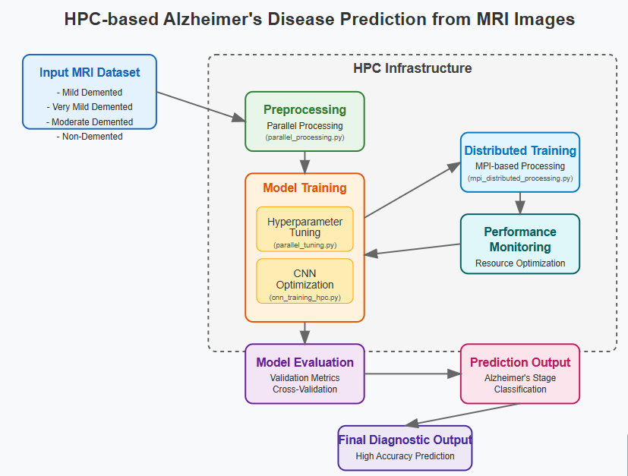
BLOCK DIAGRAM:

Slide 8
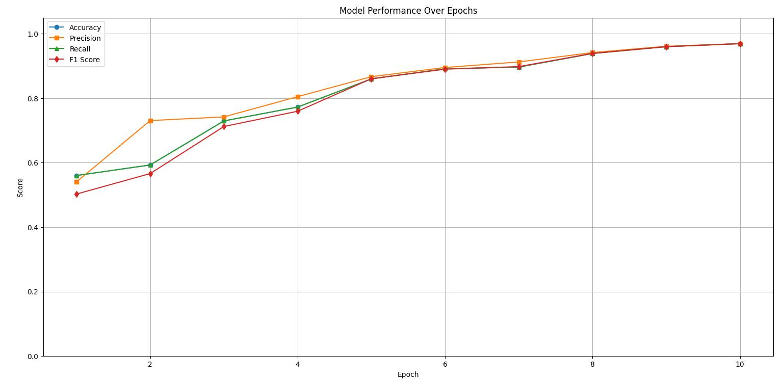
EXPERIMENTAL RESULTS:
PERFORMANCE EVALUATION:

Slide 9
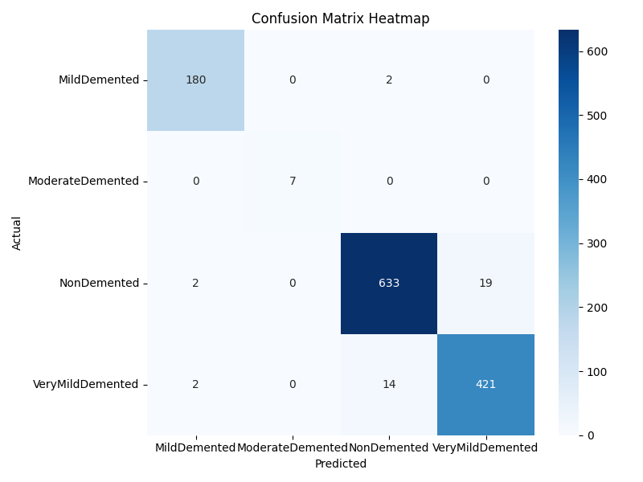
CONFUSION MATRIX:

Slide 10
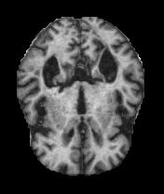
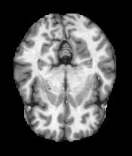
FIGURES:
MILD DEMENTED
NON DEMENTED

Slide 11
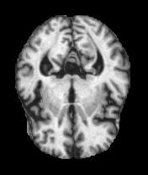
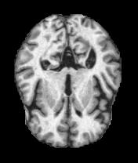
FIGURES:
MODERATE DEMENTED
VERY MILD DEMENTED

Slide 12
TABLE FORMAT:
Loss | Accuracy | Precision | Recall | F1 Score
1.0934 | 0.5602 | 0.5403 | 0.5602 | 0.5026
0.9040 | 0.5930 | 0.7307 | 0.5930 | 0.5662
0.7377 | 0.7297 | 0.7422 | 0.7297 | 0.7123
0.5053 | 0.7727 | 0.8050 | 0.7727 | 0.7598
0.3392 | 0.8602 | 0.8671 | 0.8602 | 0.8607
0.2142 | 0.8914 | 0.8954 | 0.8914 | 0.8903
0.1514 | 0.8969 | 0.9128 | 0.8969 | 0.8983
0.0956 | 0.9391 | 0.9491 | 0.9391 | 0.9393
0.0539 | 0.9602 | 0.9615 | 0.9602 | 0.9603
0.0276 | 0.9695 | 0.9696 | 0.9695 | 0.9695

Slide 13
CONCLUSION:
This Research successfully integrating HPC strategies into the deep learning pipeline significantly improved the efficiency and performance of Alzheimer’s disease classification using MRI scans. The system achieved 96.95% accuracy and an F1 score of 0.9695 by epoch 10, demonstrating strong generalization across all Alzheimer’s stages. This scalable and robust approach is well-suited for clinical deployment in large-scale medical imaging.

Slide 14
REFERENCES:
D. Pan et al., "Adaptive 3DCNN-Based Interpretable Ensemble Model for Early Diagnosis of Alzheimer’s Disease," in IEEE Transactions on Computational Social Systems, vol. 11, no. 1, pp. 247-266, Feb. 2024
DOI: 10.1109/TCSS.2022.3223999
W. Liu, Q. Dong, S. Sun, J. Shen, K. Qian and B. Hu, "Risk Prediction of Alzheimer’s Disease Conversion in Mild Cognitive Impaired Population Based on Brain Age Estimation," in IEEE Transactions on Neural Systems and Rehabilitation Engineering, vol. 31, pp. 2468-2476, 2023
DOI: 10.1109/TNSRE.2023.3247590
R. S. Jamalullah et al., "Leveraging Brain MRI for Biomedical Alzheimer’s Disease Diagnosis Using Enhanced Manta Ray Foraging Optimization Based Deep Learning," in IEEE Access, vol. 11, pp. 81921-81929, 2023
DOI: 10.1109/ACCESS.2023.3294711
T. Wang and L. Cao, "Deep Learning Based Diagnosis of Alzheimer's Disease Using Structural Magnetic Resonance Imaging: A Survey," 2021 3rd International Conference on Applied Machine Learning (ICAML), Changsha, China, 2021
DOI: 10.1109/ICAML54311.2021.00092

Slide 15
B. Thapaliya et al., "Graph-based deep learning models in the prediction of early-stage Alzheimer’s," 2024 46th Annual International Conference of the IEEE Engineering in Medicine and Biology Society (EMBC), Orlando, FL, USA, 2024
DOI: 10.1109/EMBC53108.2024.10782267
A. Kirimtat, O. Krejcar, P. Maresova, A. Selamat and K. Kuca, "Advancements in High-Performance Computing in Early Diagnosis of Alzheimer’s Disease: A Systematic Review," in IEEE Access, vol. 12, pp. 156492-156504, 2024
DOI: 10.1109/ACCESS.2024.3484928
A. S. Alatrany, W. Khan, A. J. Hussain, J. Mustafina, D. Al-Jumeily and for the Alzheimer's Disease Neuroimaging Initiative, "Transfer Learning for Classification of Alzheimer's Disease Based on Genome wide Data," in IEEE/ACM Transactions on Computational Biology and Bioinformatics, vol. 20, no. 5, pp. 2700-2711, 1 Sept.-Oct. 2023
DOI: 10.1109/TCBB.2022.3233869
G. P. Shukla, S. Kumar, S. K. Pandey, R. Agarwal, N. Varshney and A. Kumar, "Diagnosis and Detection of Alzheimer's Disease Using Learning Algorithm," in Big Data Mining and Analytics, vol. 6, no. 4, pp. 504-512, December 2023
DOI: 10.26599/BDMA.2022.9020049

Slide 16
C. -M. Kim and W. Lee, "Classification of Alzheimer’s Disease Using Ensemble Convolutional Neural Network with LFA Algorithm," in IEEE Access, vol. 11, pp. 143004-143015, 2023
DOI: 10.1109/ACCESS.2023.3342917
G. N. Alwakid, S. Tahir, M. Humayun, W. Gouda, "Improving Alzheimer’s Detection with Deep Learning and Image Processing Techniques," in IEEE Access, vol. 12, pp. 153445-153456, 2024
DOI: 10.1109/ACCESS.2024.3481238

Slide 17

THANK YOU!!

